Slide 1
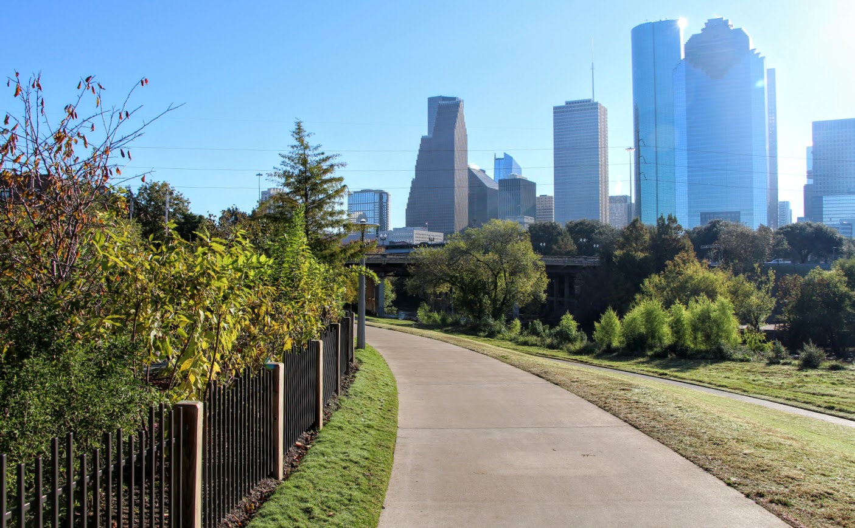


Str ll
Let’s take a stroll…

Slide 2
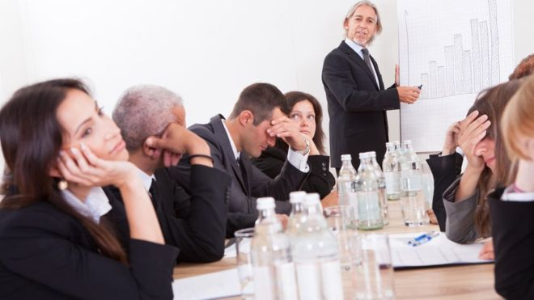
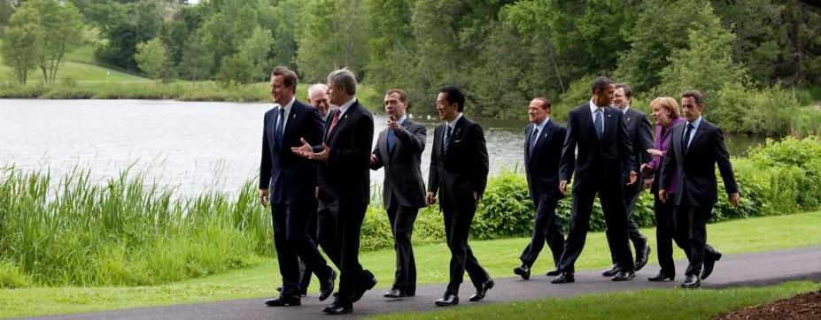
Hard to stay focused
Loss of stimulation
Not engaging
Take the meeting on a Stroll
Lots around for more stimulation
More engaging

Slide 3


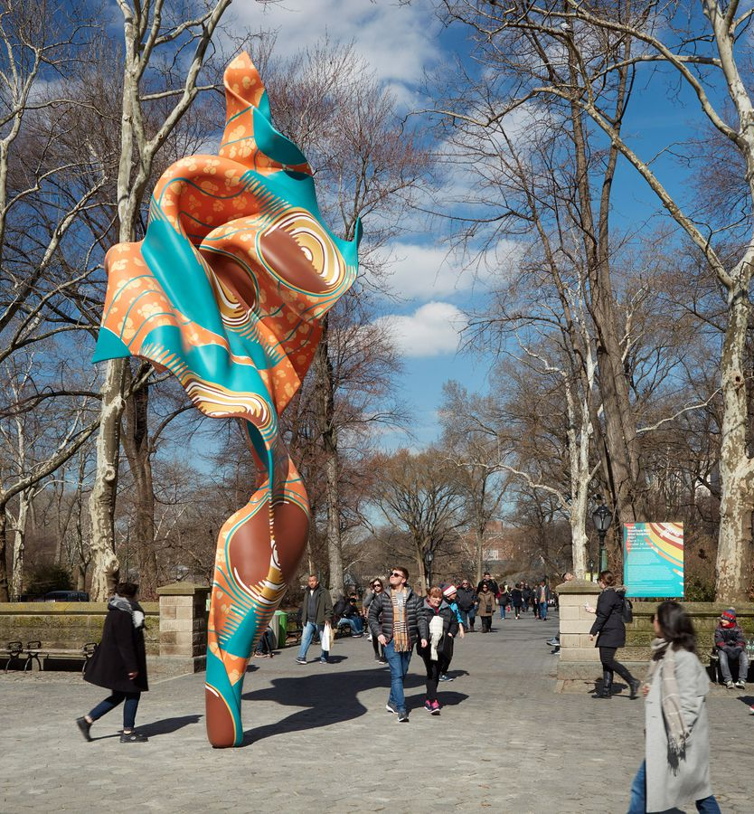
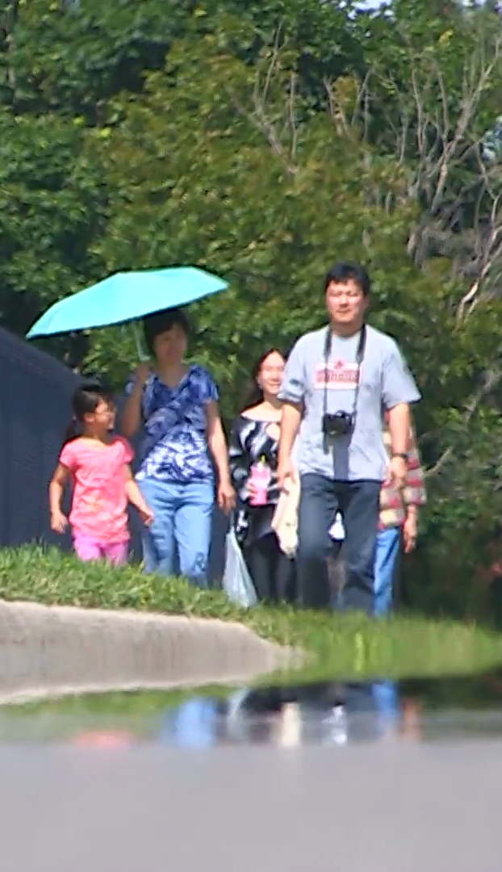
Time managed walk
Most engaging walk
Staying in or out of the Sun
Unfamiliar area

Slide 4
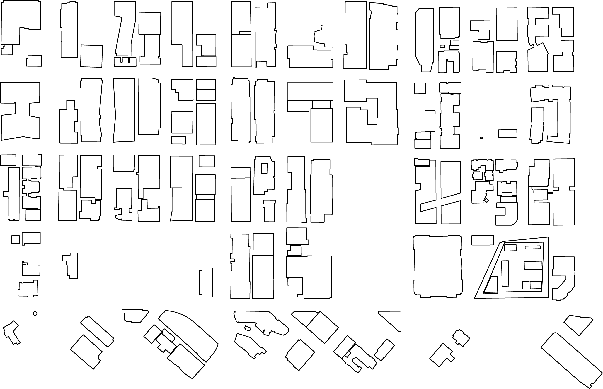
Take a Stroll anywhere!!
Your Office
Client’s Office
University Campus

Slide 5
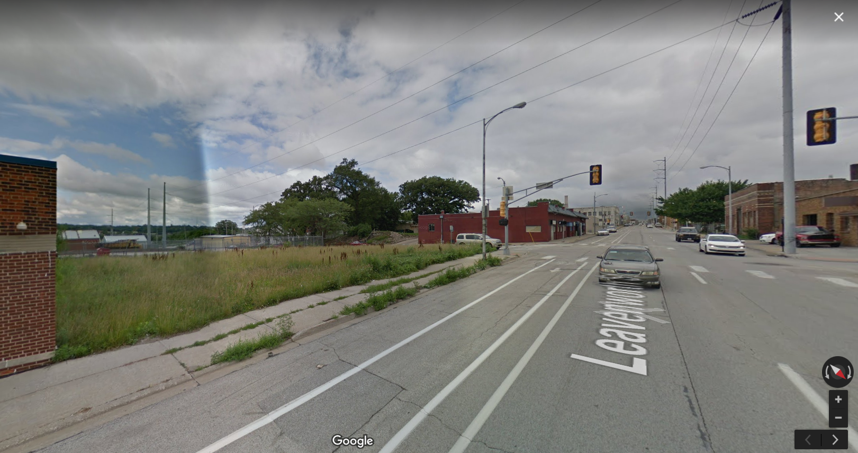
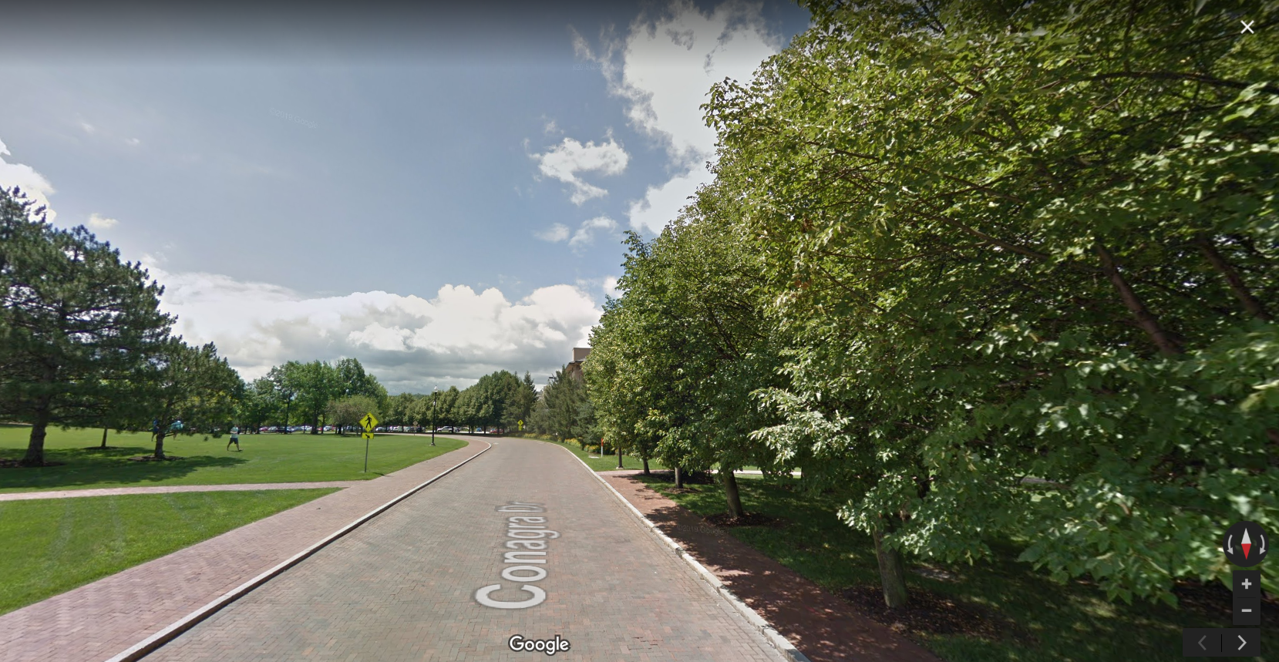

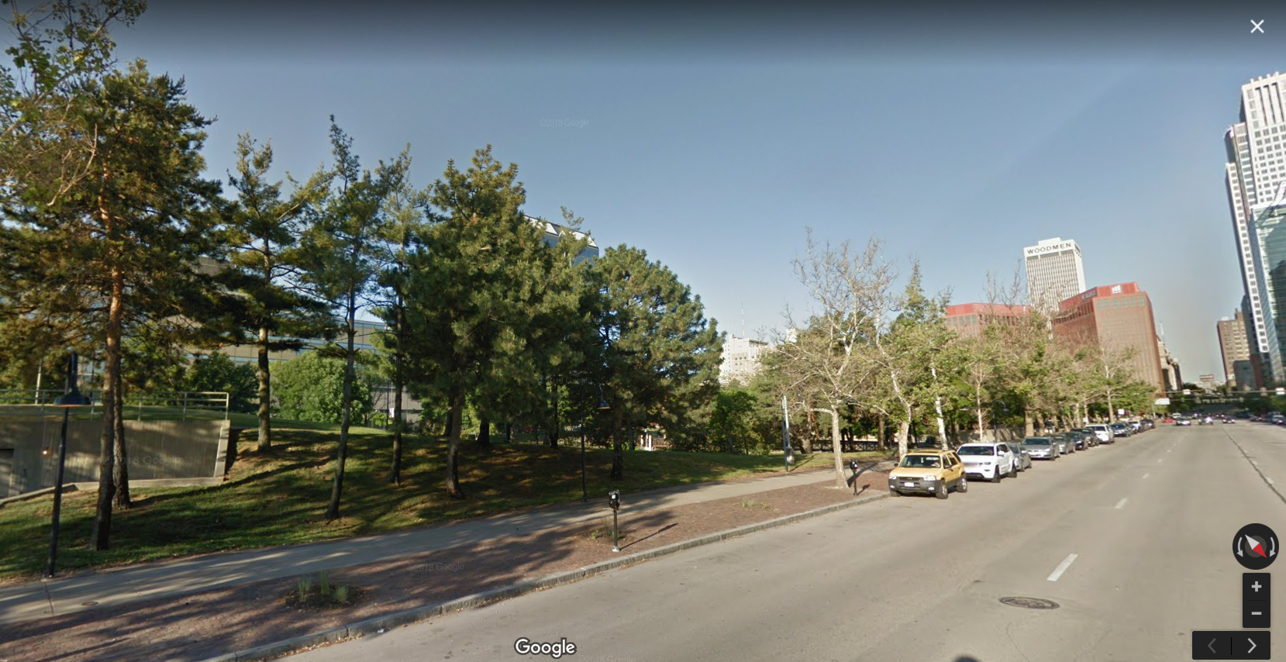
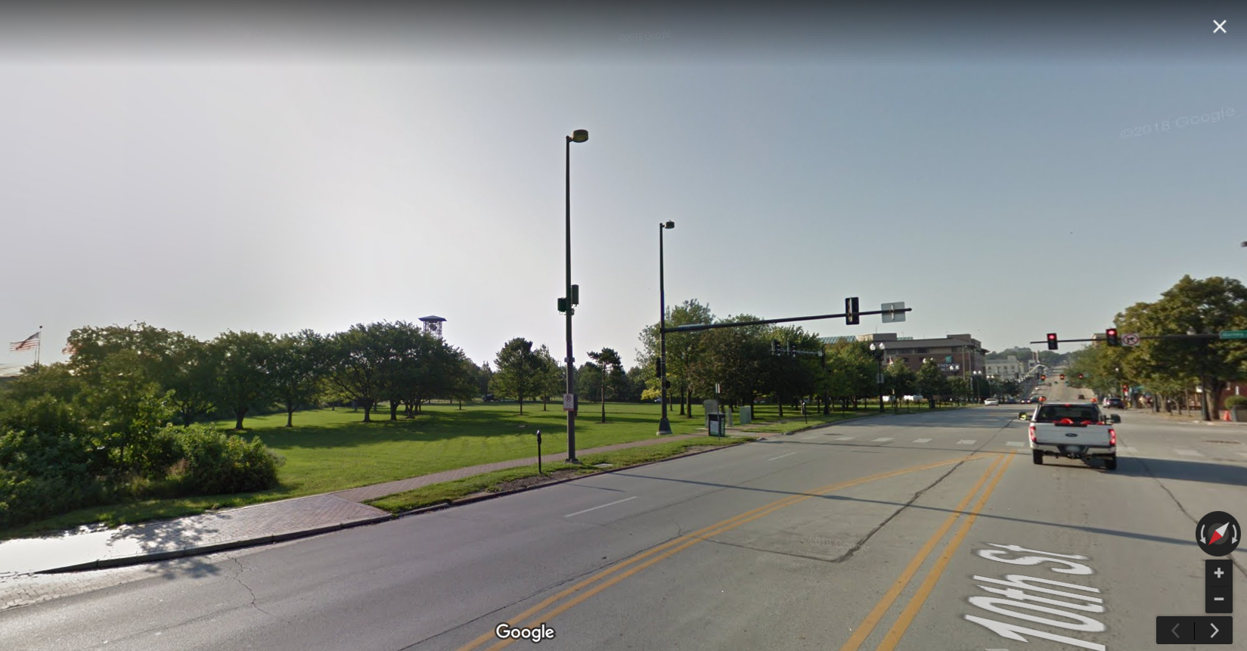
But not just any Stroll…
A curated Stroll just for you
40
90
80
70

Slide 6
10 min
Choosing a time duration for your Stoll is as easy as a click of a button.
25 min
15 min

Slide 7
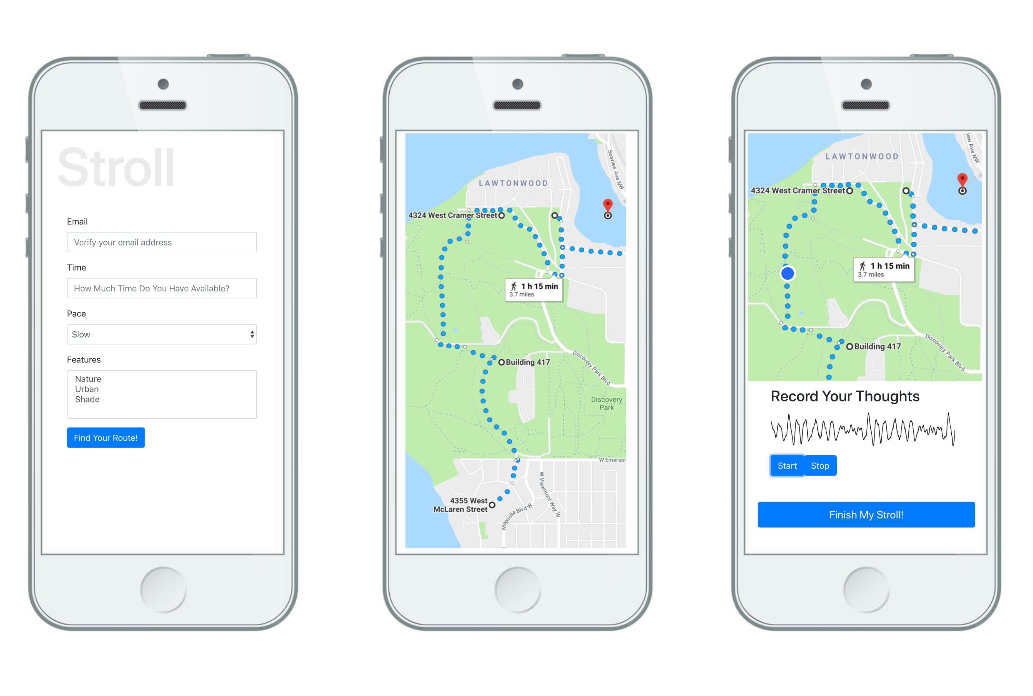

Slide 8
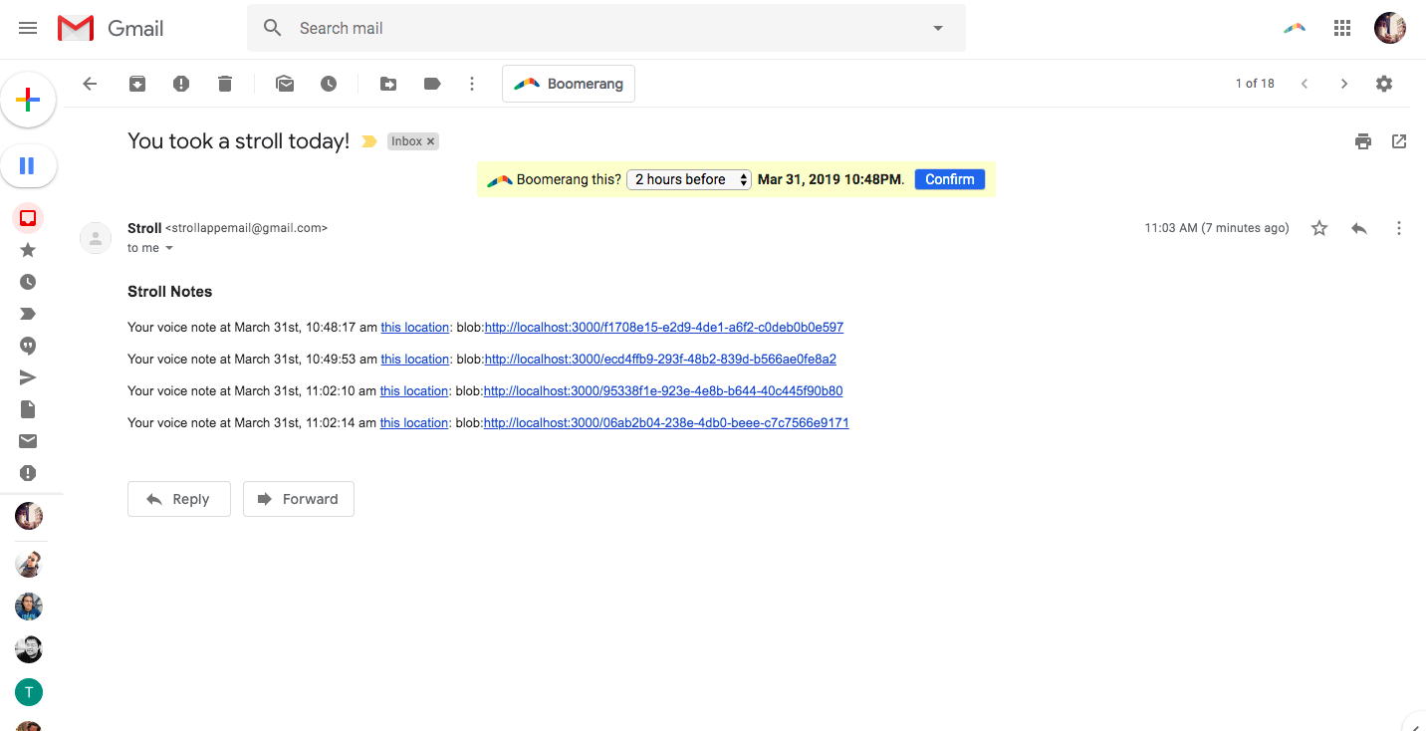

Slide 9
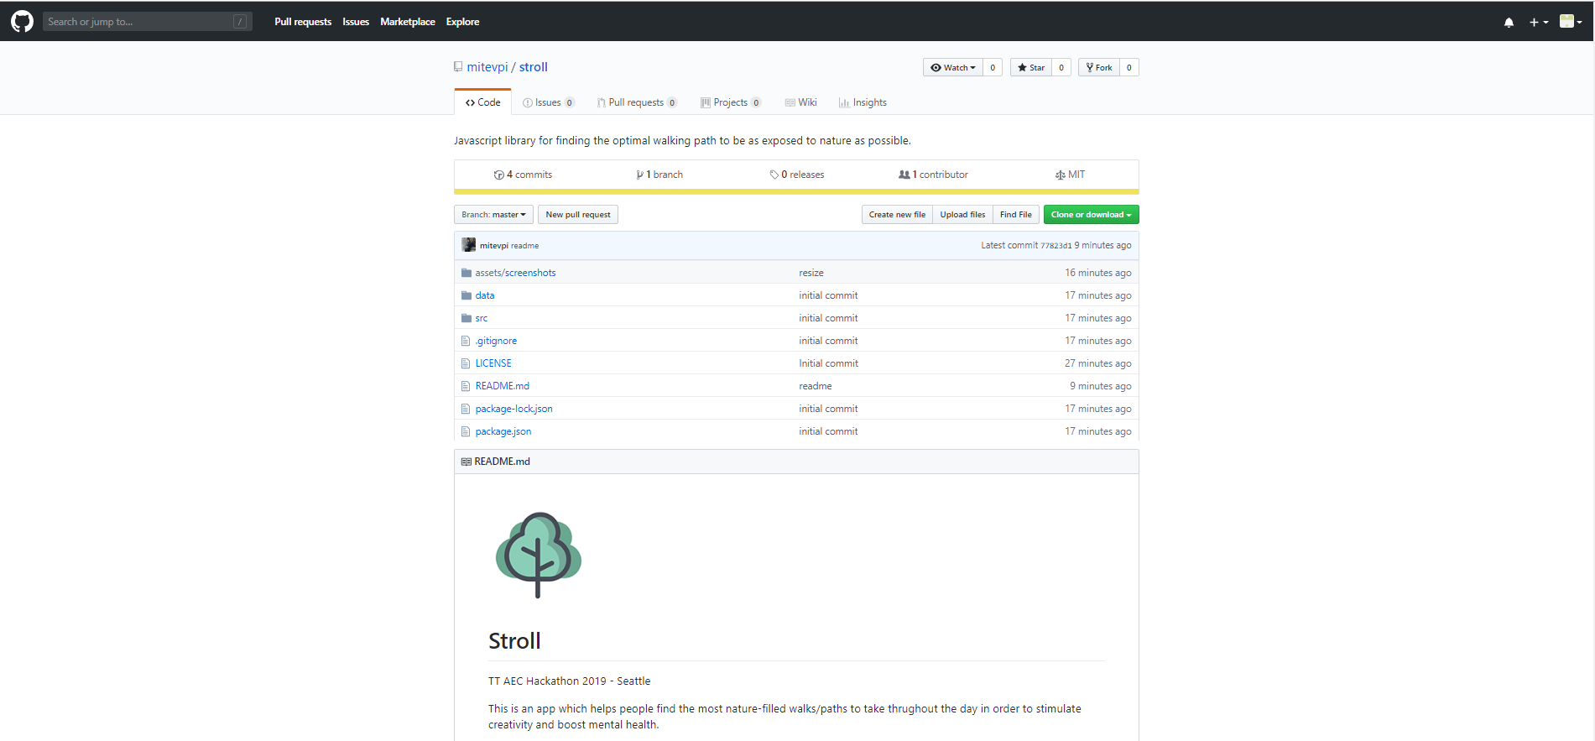

Slide 10
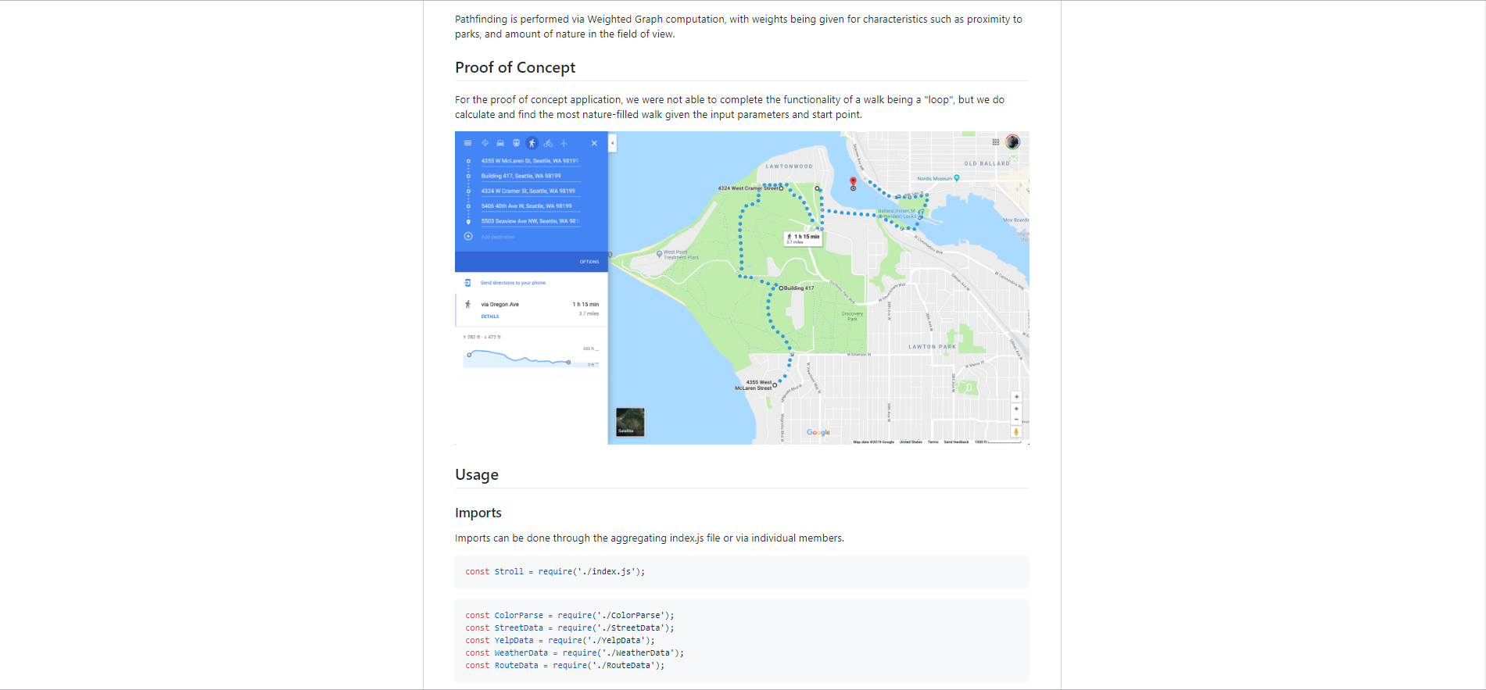

Slide 11
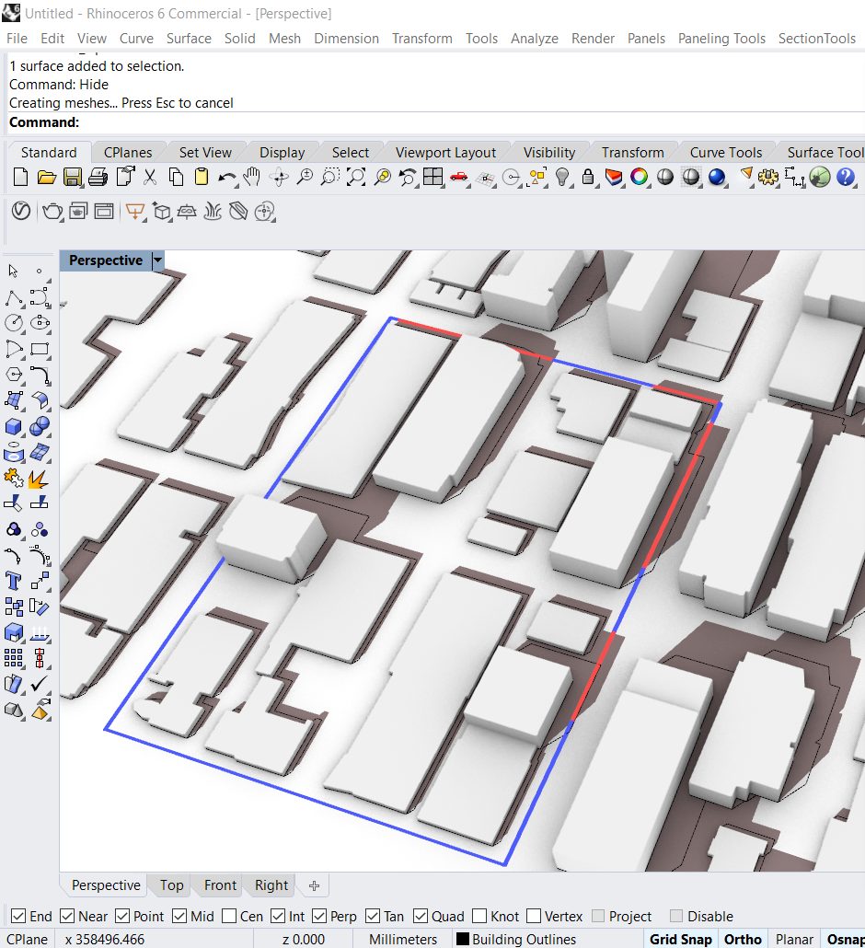
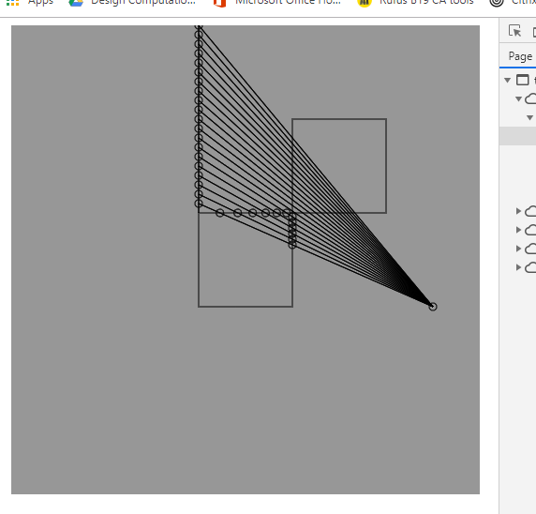

Slide 12
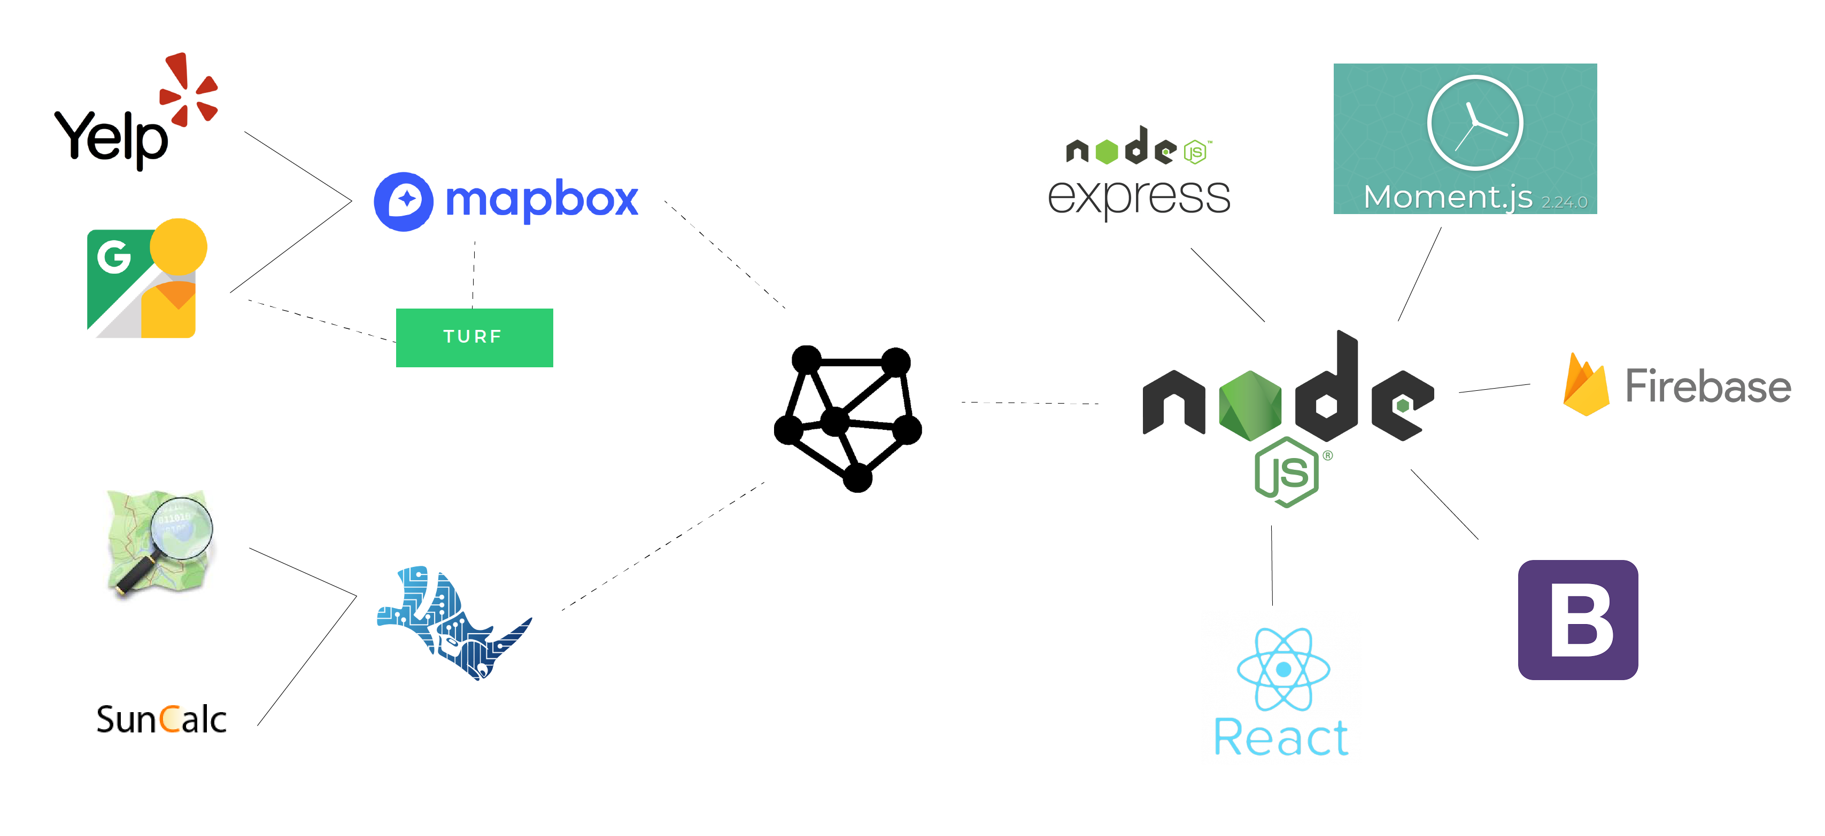

Slide 13
